Slide 1



Slide 2
TomTom Mydrive RoadTrips
SmartBin
Siddhartha S Das

Slide 3
Problem Statement

Slide 4
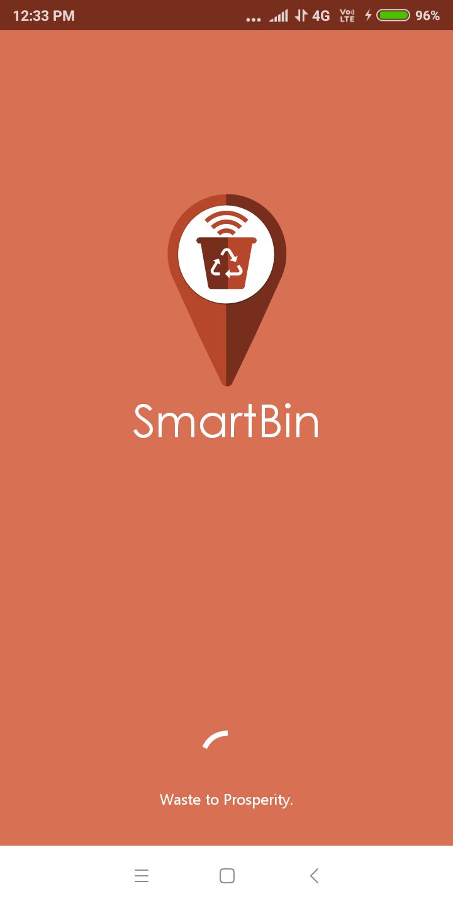
Problem Statement
In urban areas, garbage and all of its kind collection is a hectic and long process. Developing cities like Delhi, Mumbai, Bangalore faces this issue. When garbage collection for day missed out it creates foul smell, diseases.
SmartBin an IoT based soluion helps to let know the Garbage collection department where to collect the waste (house based), their place and which route to take so that they can cover shortest path.

Slide 5
Solution approach and architecture

Slide 6
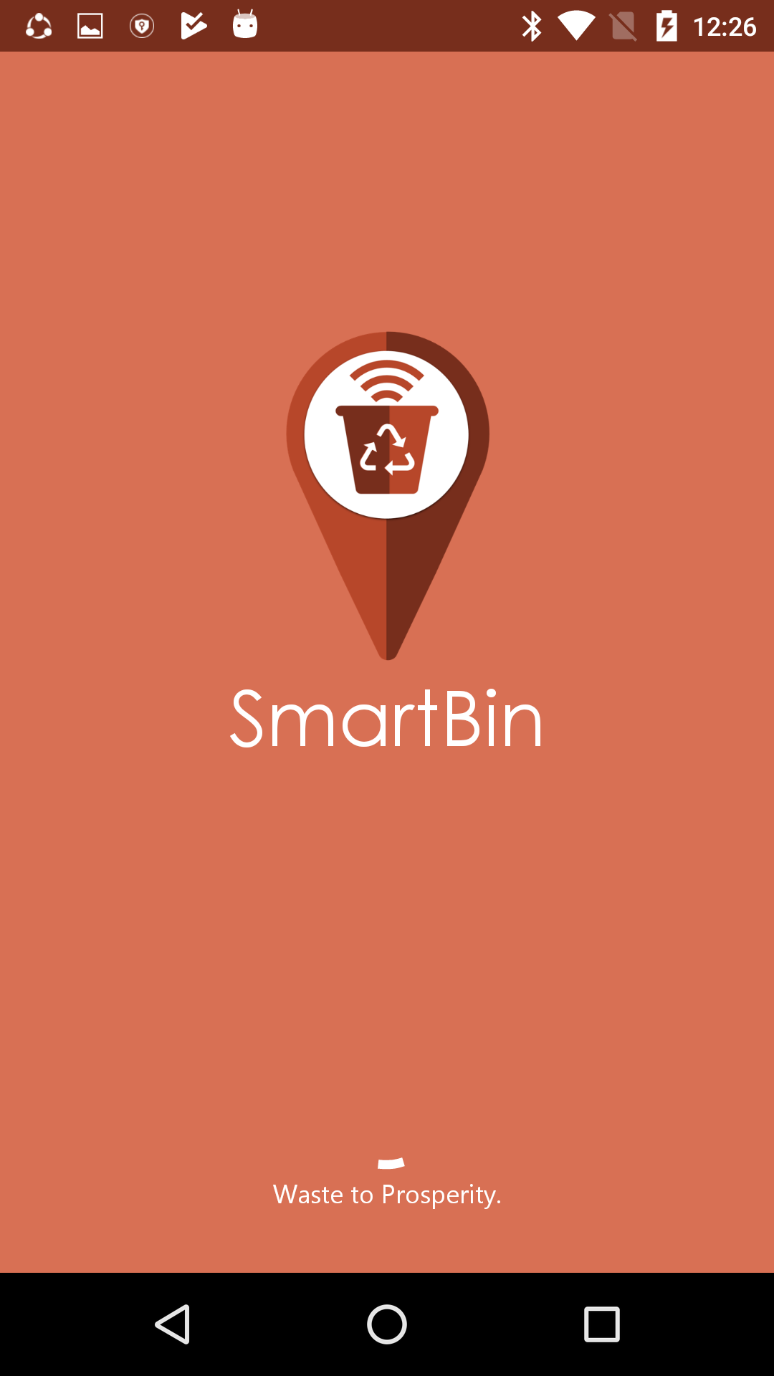
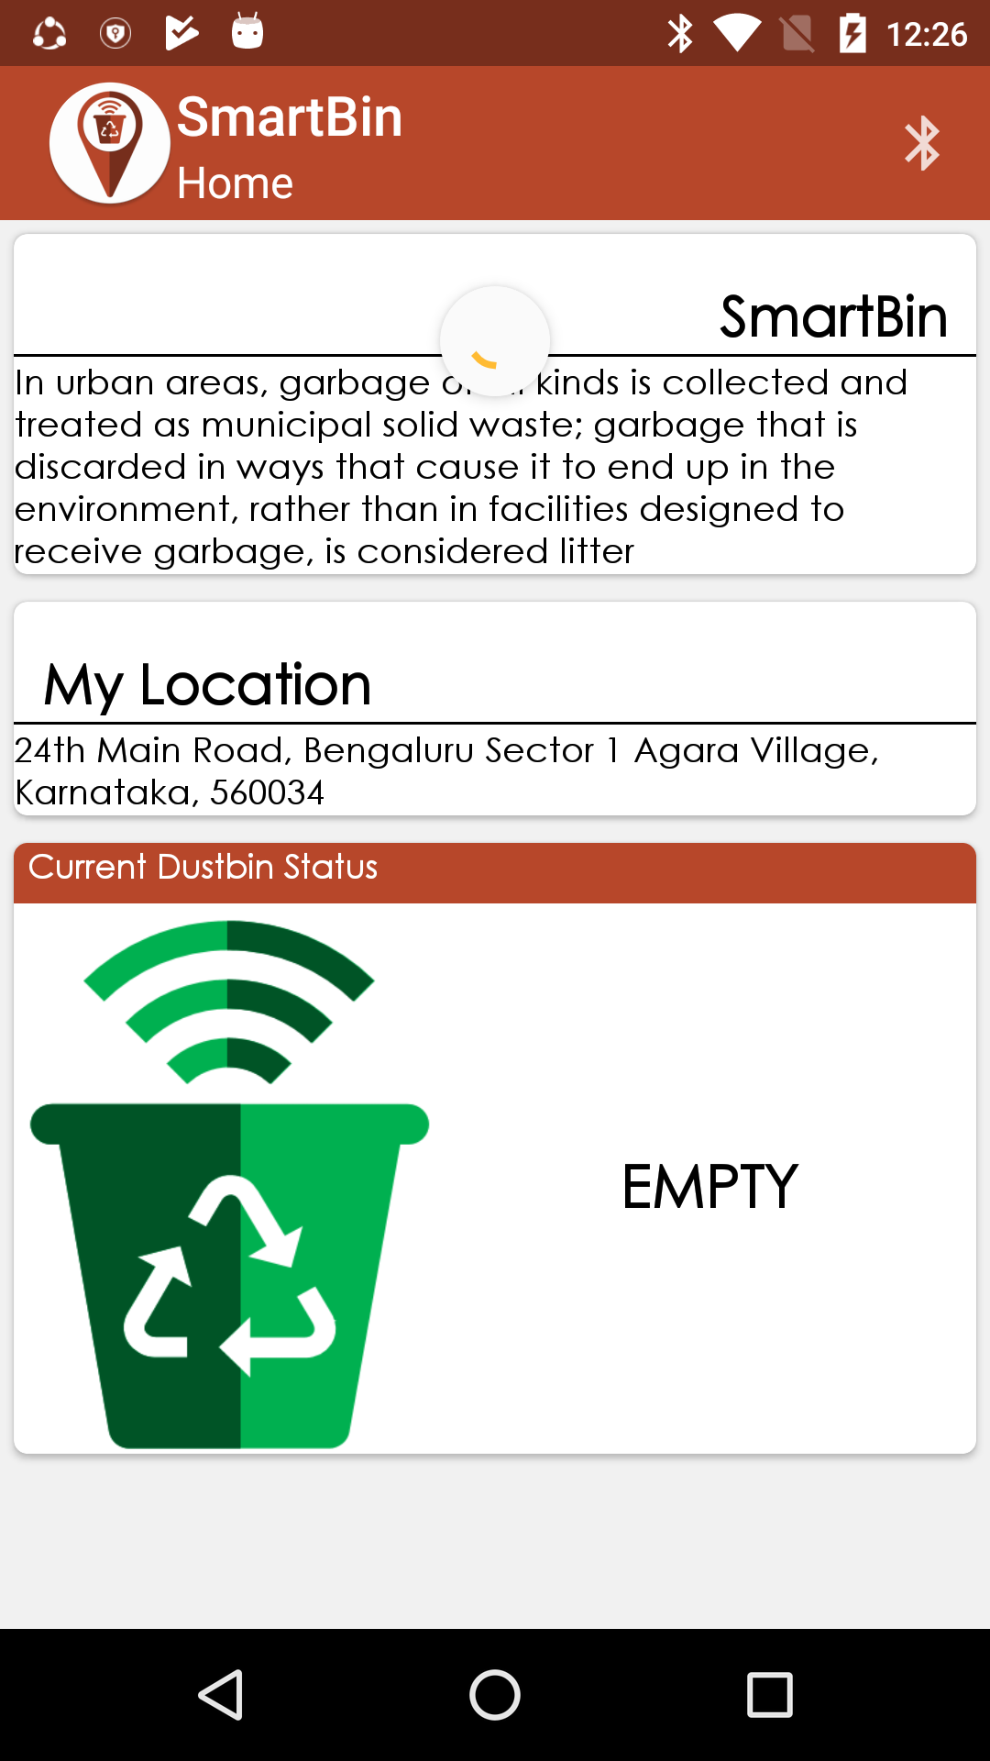
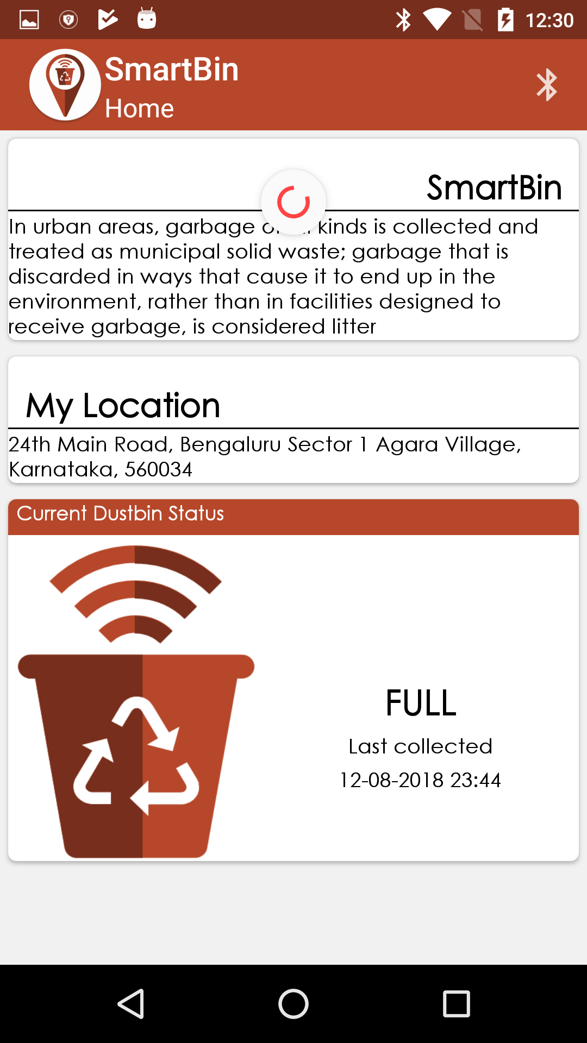
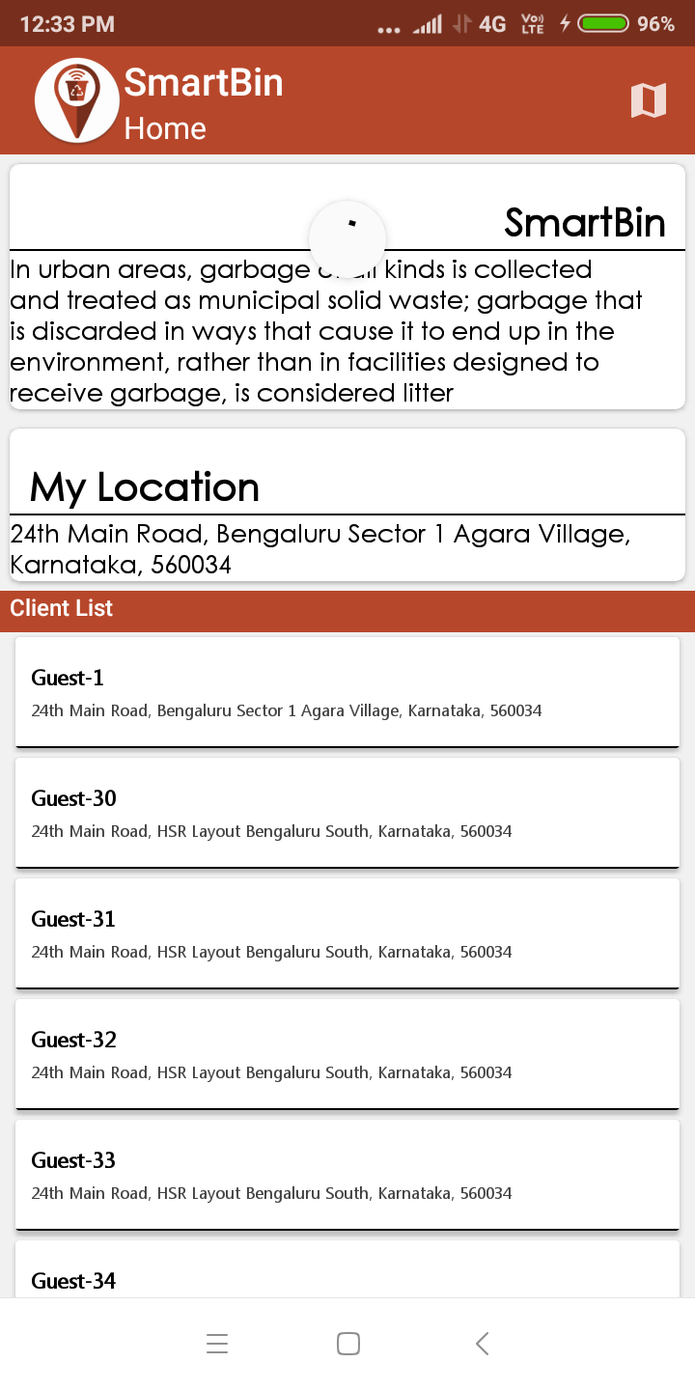
Solution
Android Application
Client – Updates current location, can connect to SmartBin, check the status of the SmartBin (Full or Empty)

Slide 7
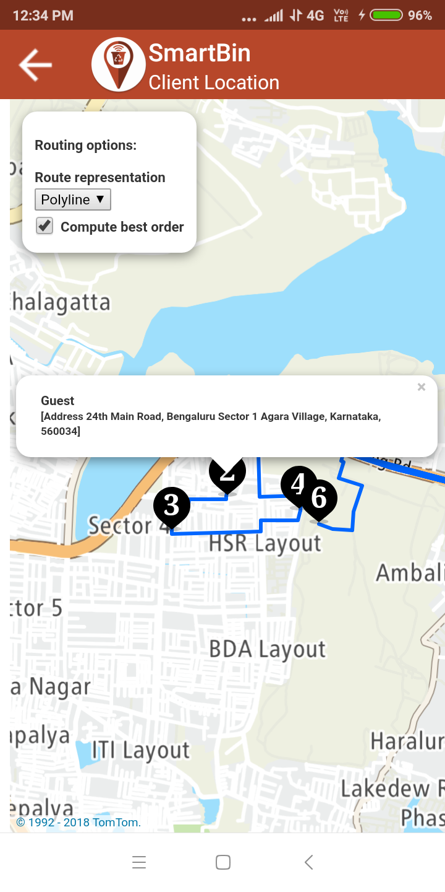
Solution
Android Application
Collector – Checks all Client need to be collected, there address, location and shortest path to be covered to cover all the Client

Slide 8
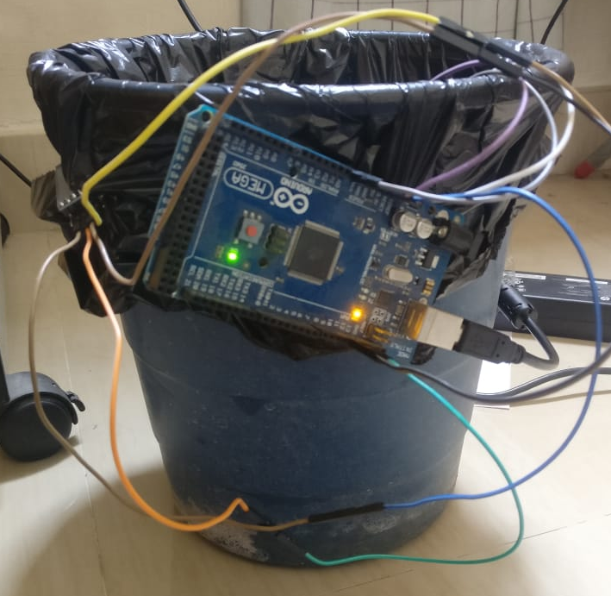

Architecture
Smart Bin
Android App
(Client Application)
Android App
(Collector Application)
TomTom Online Maps API
TomTom Online Routes API
Web Service
(php)
Tom Tom api for location
MYSQL

Slide 9
Technology/Tool/Cloud Stack

Slide 10
Technical Resources
Programming Languages
php
Java
APIs
TomTom location API
TomTom Online Maps API
TomTom Online Routes API
Tools
Android Studio
Sublime
Postman
Aurdino
Xamp
ngnork

Slide 11
Hardware Specifications

Slide 12
Hardware
Proximity Sensor :- It is used to detect the presence of nearby objects without any physical contact.
Arduino Mega :- The Arduino Mega 2560 is a microcontroller board based on the ATmega2560 (datasheet). It has 54 digital input/output pins (of which 14 can be used as PWM outputs), 16 analog inputs, 4 UARTs (hardware serial ports), a 16 MHz crystal oscillator, a USB connection, a power jack, an ICSP header, and a reset button.
HC05(Bluetooth Sensor) :-HC‐05 module is an easy to use Bluetooth SPP (Serial Port Protocol) module, designed for transparent wireless serial connection setup. The HC-05 Bluetooth Module can be used in a Master or Slave configuration, making it a great solution for wireless communication.

Slide 13
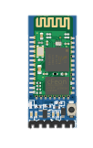

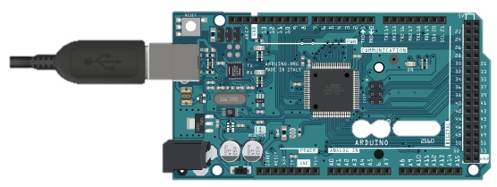
Hardware
IR Pair
HC-05
Aurdino Mega 2560

Slide 14
Demo
(Pictures)

Slide 15
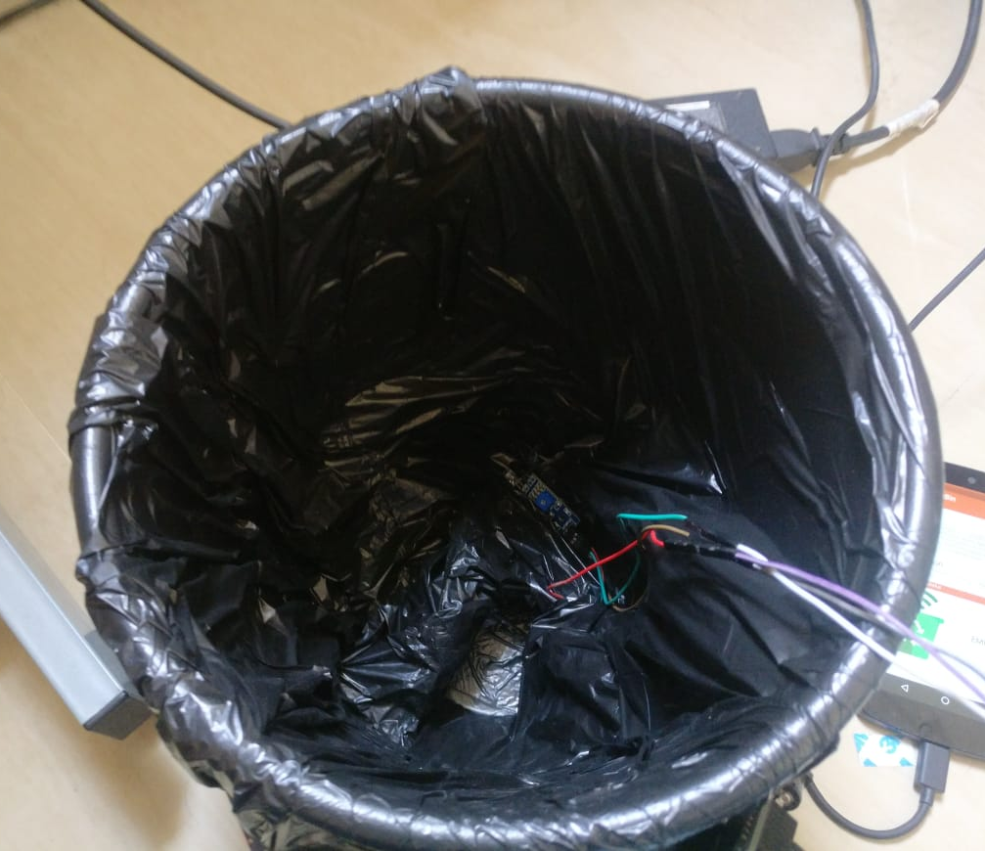
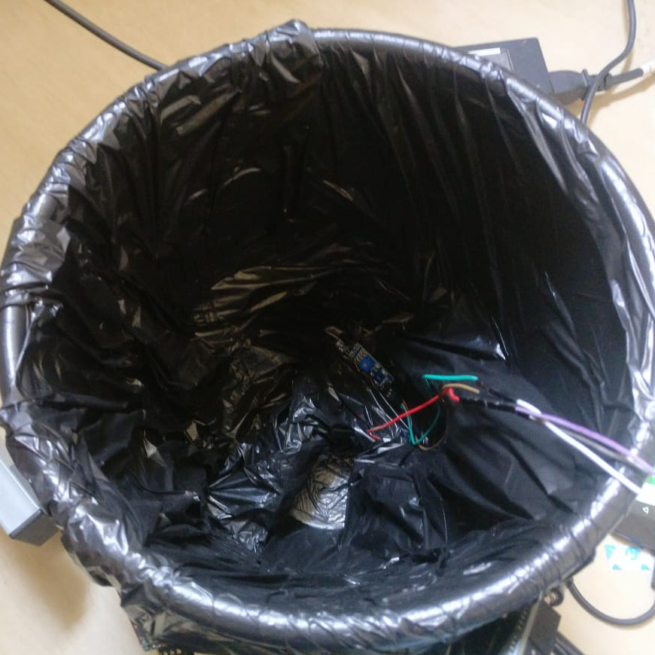
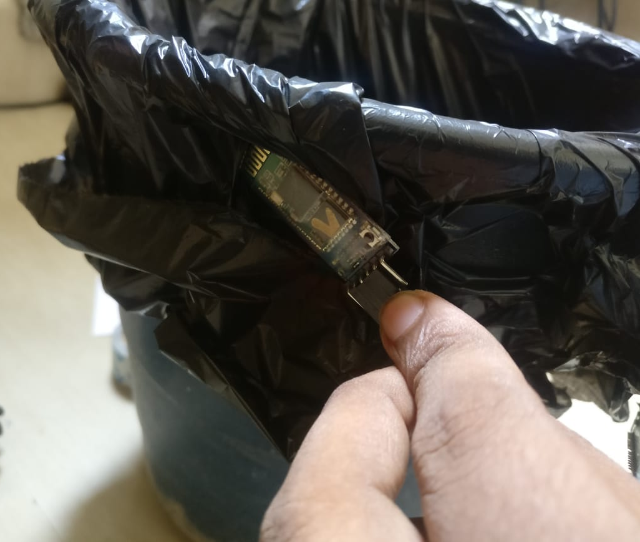
Picture Gallery- Smart Bin
SmartBin Proto type with HC-05, IR Pair & Aurdino

Slide 16
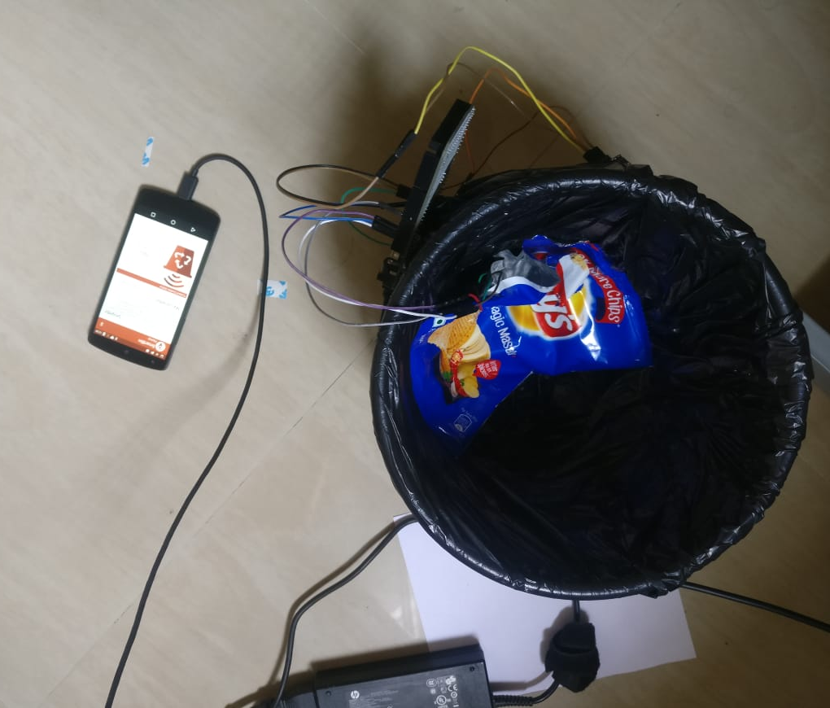
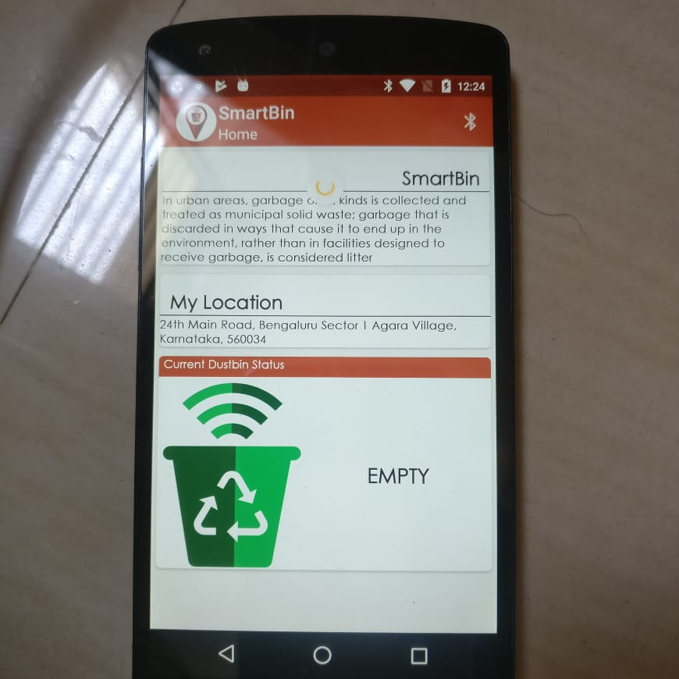
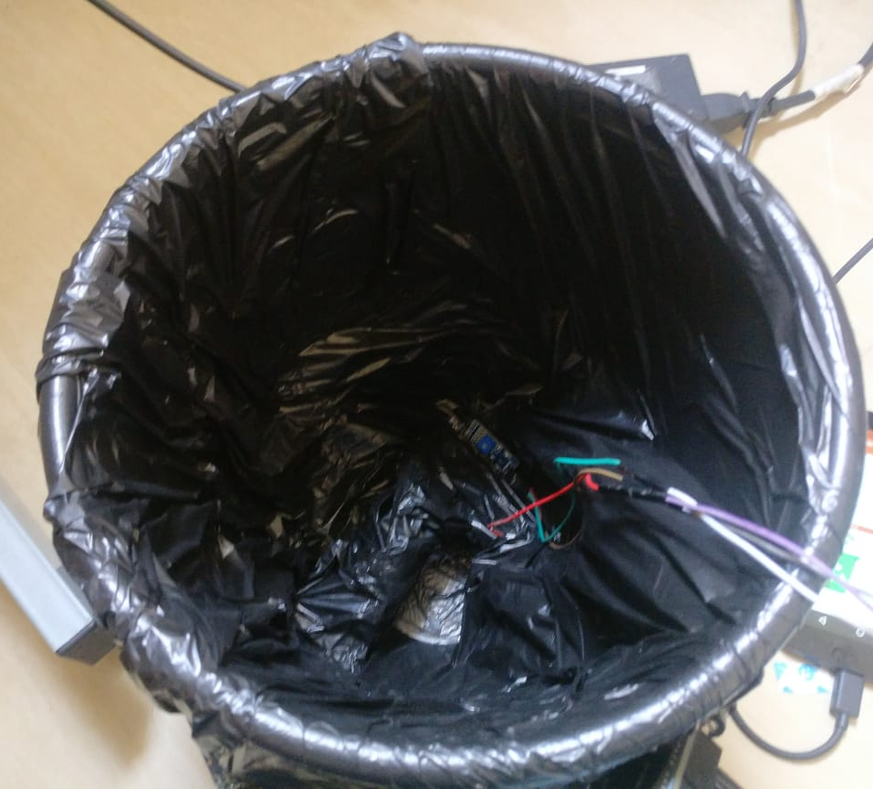
Empty & Full Bin Demo

Slide 17
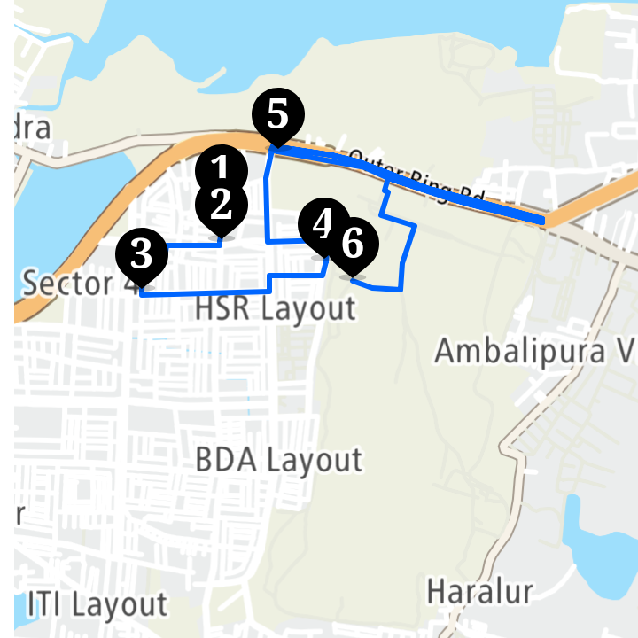
Collector App Demo

Slide 18
Challenges faced
POI based – api (Specific number for type of Poi like shops, clinic will help )
Json output for shortest path algorithm
Marker updating code missing in documentation later received from support team,

Slide 19
Why this POC should be considered for final round?
Garbage collection is multi-dollar industry globally it generates 410 billion dollar revenue.
India is developing industry, currently there are no private player in garbage collection.
Telangana has already started IoT roll out for garbage collection big players like Airtel are planning as IoT partner.
SmartBin solution with help of TomTom Apis will ease the work and save money & time which wasted in terms of routing.

Slide 20
Future Updates

Slide 21
Future Updates
Instead of using IR sensor and Bluetooth module, pressure sensors and WiFi module can to be used.
Website to check for admin managing users
Notification of empty and filled status, distinguish between wet and dry waste
ML to predict how much waste need to be collected which areas are on high priority.

Slide 22
Thank You

